Slide 1

SOFTWARE GROUP PROJECT (SGP)
SPLITRIDE WEB APPLICATION
MENTOR: PROF. JIGNESH PATEL
4CSE-2
GROUP –
D21CS110-Swet Soni
D21CS111-Yatin Parmar

Slide 2
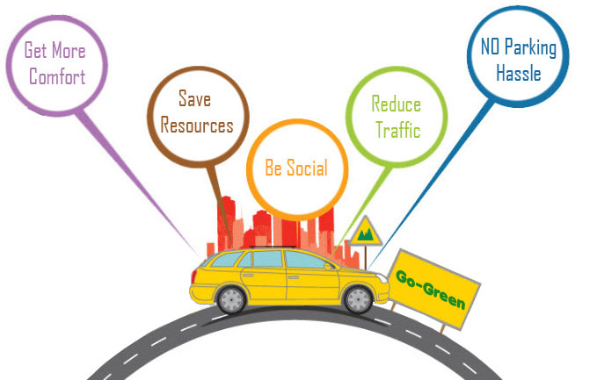
SPLIT RIDE

Slide 3


PURPOSE OF SPLIT RIDE
The main idea of SplitRide is that a group of people can ride in one vehicle instead of having individuals driving their own car or riding in hired cars. They can take turns using their cars so that there is savings in terms of money as well as emissions or else ask for one car to pick and ride so as to reduce number of cars deployed.
SplitRide is also extended to company officials travelling to outside locations.
Travelling by company busses is the first option. Cars to be used on need basis only.

Slide 4
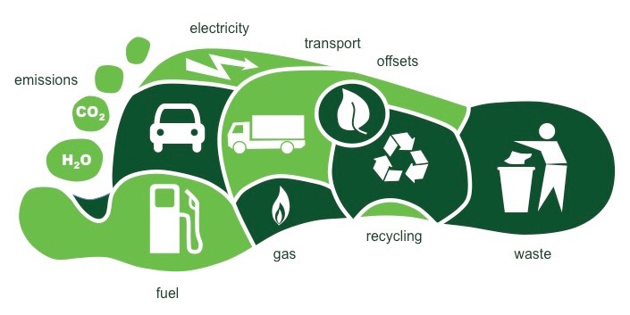

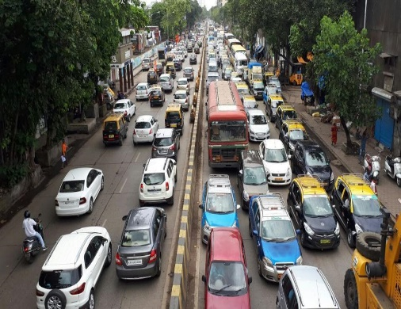
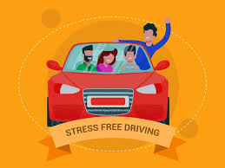
SPLIT RIDE BENEFITS
Reduces the carbon footprint per employee and for the organization
Cuts fuel costs drastically and saves money
Reduces potential risks on roads and helps in decongestion of traffic
Lessens the stress of driving Improves the cultural integration of the organization

Slide 5
LIMITATION OF PROJECT
User/Passenger cannot track the driver
Cannot be used on other operating systems.
Security issues.
New people tends to struggle from lack of users.
Only few percentage of all commuters carpool due reasons such as finding people willing to carpool with them.
Fails at some level while dealing with issues like payment, security and real-time tracking.

Slide 6
FUNCTIONALITY OF SPLIT RIDE
Now lets come to the functionality of the system. So in this system we will have two options for the user, first is driver and other is passenger.
Both the option will be available from the normal login. There will be no different login option for individual facility. Both the functions can be operated through the normal login.

Slide 7
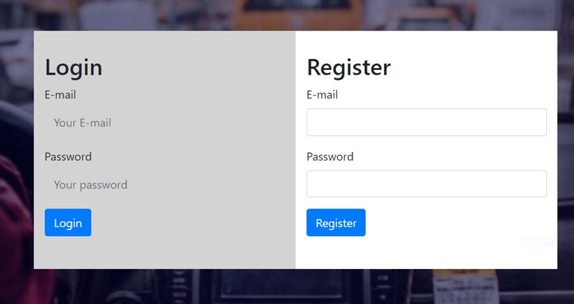
REGISTER & LOGIN
On opening the system first of all you need to register yourself by giving your email id and setting a password to it.
After making yourself register, you can login with the register email id and you need to entered the password which you have set for that particular id.

Slide 8
After entering the system you have to interact with side navigation bar. There are total five function available. First one is Home on clicking it you will be sent back to the home page of the application. Second is Driver, on clicking it two more sub options will pop out.
Third is Passenger option, clicking on it again two more sub options will pop out. Fourth one is Contact button, it will redirect you to the contact page and the last one is logout button.

Slide 9

HARDWARE & SOFTWARE REQUIREMENTS
Hardware Requirements :
Hard Disk : 2GB
Ram : 512MB
Software Requirements:
Language: HTML, CSS, JAVASCRIPT, PHP, MYSQL
Database: PHP, MYSQL
IDE : Visual Studio Code
Web Browser : Google or any compactible browser
Operating System: Windows XP or above

Slide 10
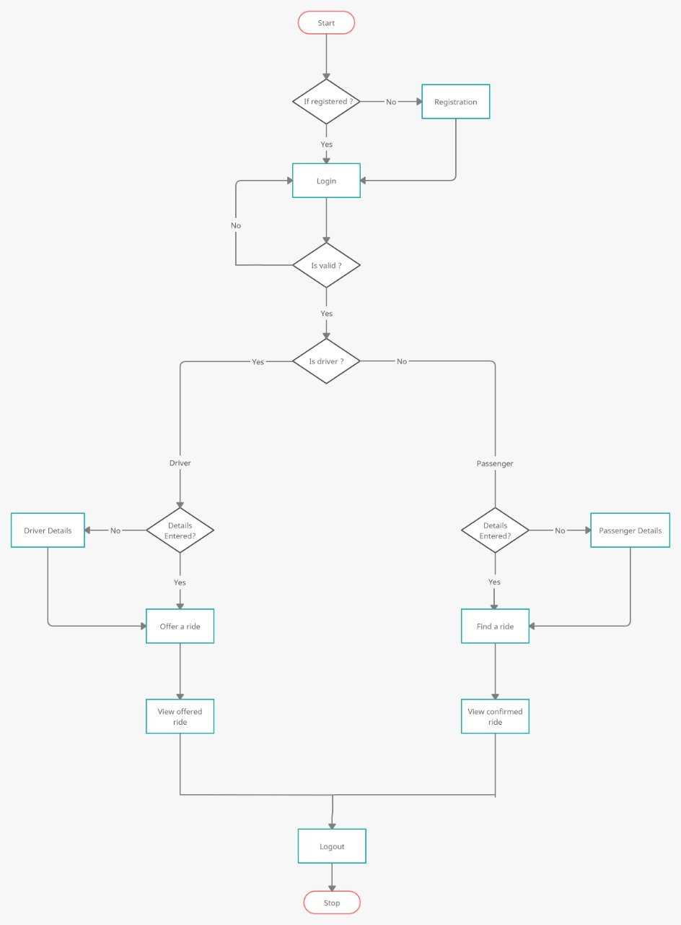

Slide 11

DO’s & DONT’s
Communication with your fellow car-poolers
Drive safely at all times
Respect any other restrictions the carpool has agreed on, such as smoking, eating or drinking
Stop making a habit of being late
Do not ask your car-poolers to make extra stops along the way
Avoid having lengthy cell phone conversations while you are in the carpool. Which can might disturb other car-poolers

Slide 12
FUTURE ENHANCEMENTS
GPS Navigation Device: GPS Navigation device is used to determine driver’s route. In this, the user with current location retrieves the list of users whose location is near to the user by using the Google maps who wants to join ride.
Mobile Application: A user friendly mobile application which can be used easily by any age group person.
Security Patches: Need to work on the security of the application. So that it can establish trust between driver and passenger. Also by gaining trust we can gain more number of passenger.

Slide 13
REFERENCE:-
https://www.javatpoint.com/phpmyadmin
https://www.edureka.co/blog/connect-mysql-database-in-java
https://www.javatpoint.com/example-to-connect-to-the-mysql-database
https://www.blablacar.in/
https://www.thapatechnical.com/2020/03/how-to-send-mail-from-localhost-xampp.html
https://www.w3schools.com/php/default.asp

Slide 14
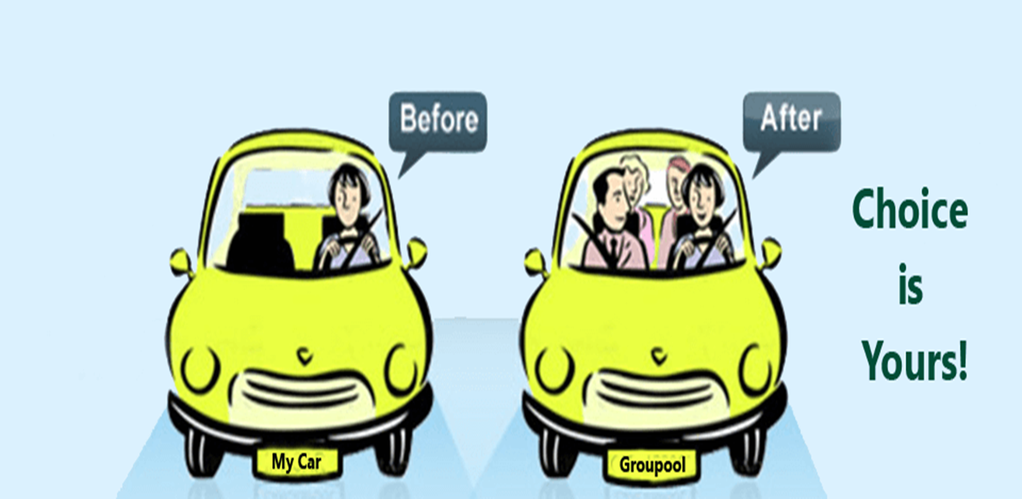


Slide 15

THANK YOU

